Slide 1


Special topics
Session 11
Al-Zahra university
Maryam zim
@maryamzim maryamxiim@gmail.com

Slide 2
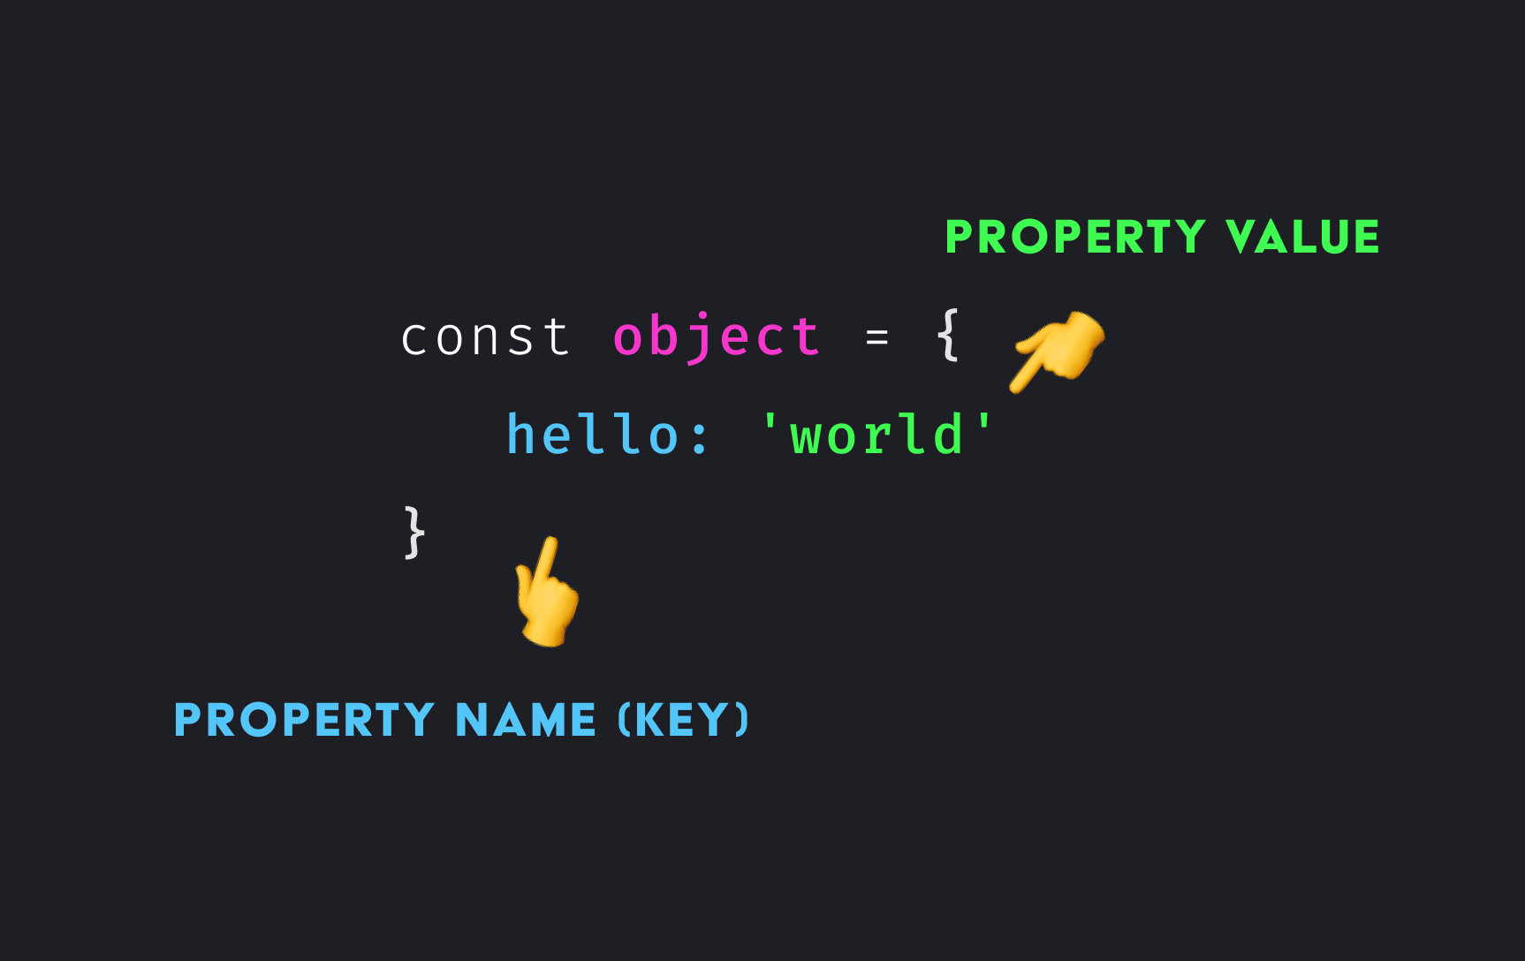
Objects :
An object in JavaScript is a collection of named values, similar to a real-world entity (like a car, a student, or a phone). Structure: Key-Value Pairs
Each object is made up of Key-Value Pairs:
Key: Always a String or a Symbol. Specifies the name of the property.
Value: Can be any data type (string, number, boolean, array, function, or even another object!).
Objects are collections of key-value pairs, where each key (known as property names) has a value.
Objects can describe anything like houses, cars, people, animals, or any other subjects.

Slide 3
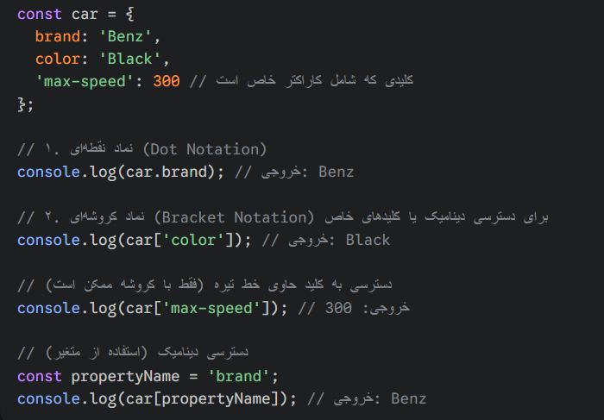
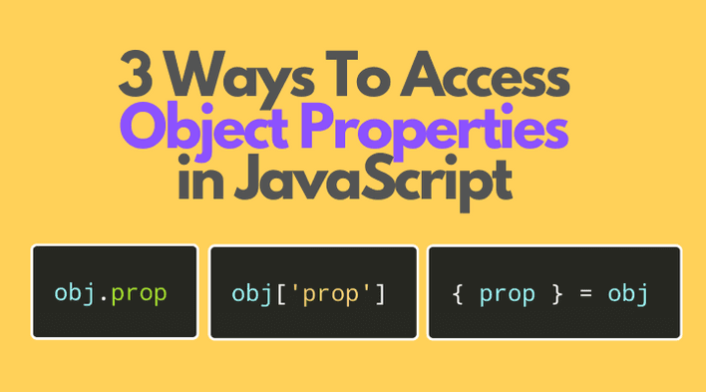
accessors :
Property accessors provide access to an object's properties by using the dot notation or the bracket notation.
1.Dot Notation: The most common and cleanest method. (Example: object.key)
2.Bracket Notation: Used when the key is a variable name or contains a space/special character. (Example: object['key'] or object[variable])

Slide 4

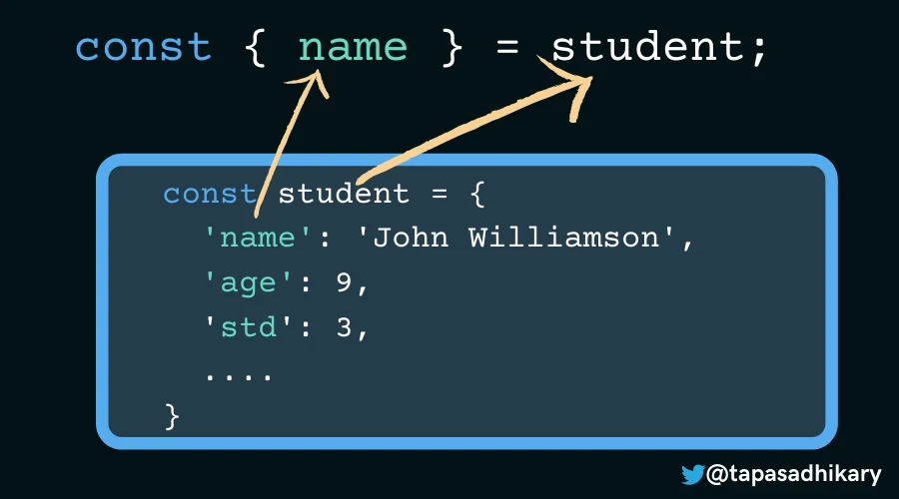
صرفا جهت اطلاع :
مورد سوم صفحه قبل تو امتحان تون نمیاد اما اسمش destruct کردن هست
بیشتر اینو میگم ک بدونین – از لحاظ حرفه ای تر بودن –
به این صورت عمل میکنه:

Slide 5
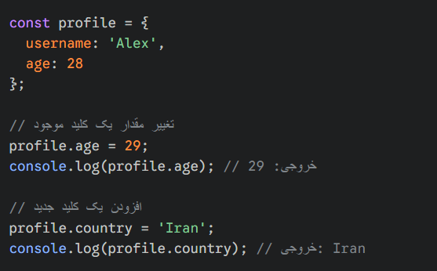
Adding, Updating, Deleting in Objects:
Because objects are mutable, you can easily change them:
Modify/Add: Simply assign a new value to the key using any of the accessors.

Slide 6
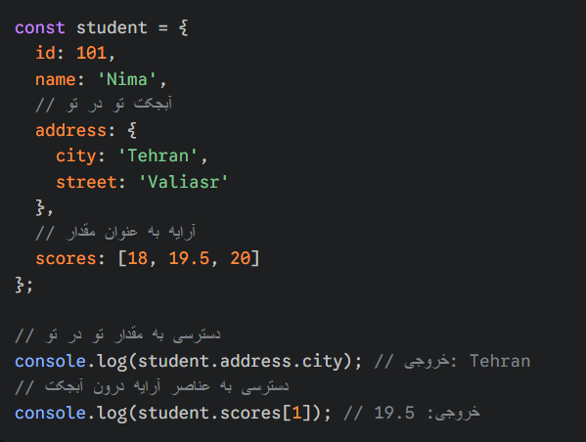
Nested Objects:
A key value can itself be an array or another object.

Slide 7
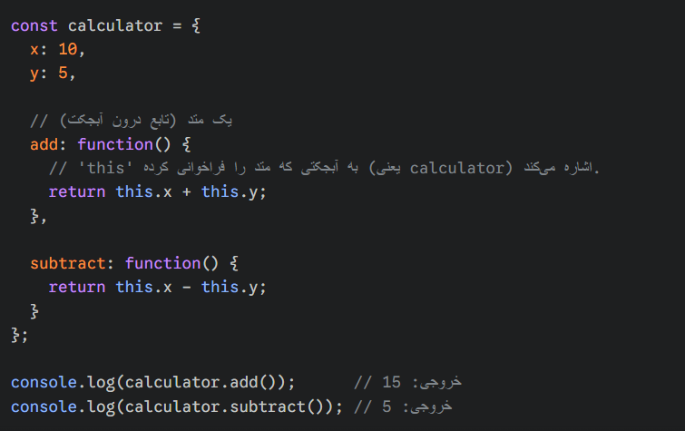
Object Methods:
If the value of a key is a function, it is called a method. Methods perform behaviors associated with that object.
Important: The this keyword inside a method refers to the object itself and allows you to access its other properties.

Slide 8
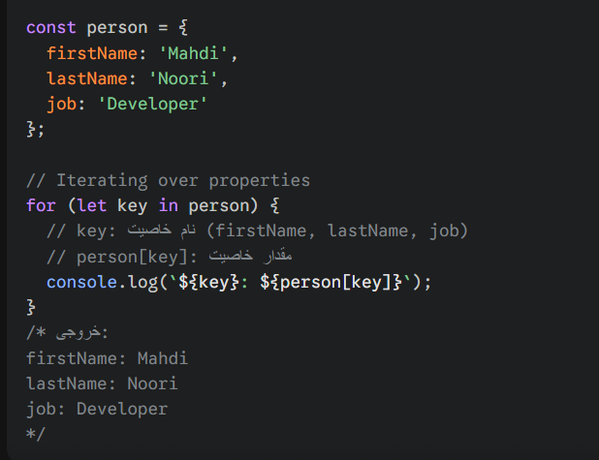
Iteration and Key Utilities:
Iteration with for...in
The for...in loop is used to access all the keys of an object.

Slide 9
Built-in Object Methods:
JavaScript provides some very useful methods on Object itself (capitalized), which are essential for working with keys, values, and pairs:
method
Object.keys(obj)
Object.values(obj)
Object.entries(obj)
Example | Description
['firstName', 'lastName', 'job'] | Returns an array of object keys.
['Mahdi', 'Noori', 'Developer'] | Returns an array of object values.
[['firstName', 'Mahdi'], ...] | Returns an array of [key, value] pairs (2-element arrays).

Slide 10
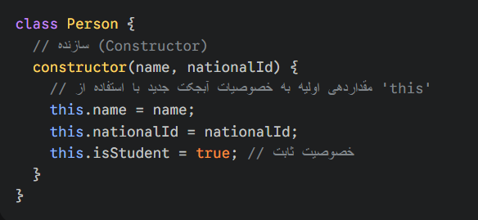
Classes:
Class A template or blueprint for building similar objects. (You build Person objects, not just a person.)
The Core Structure:
A class is defined with the class keyword. The most important part is a special method called the constructor:
constructor: A function that is executed only once when a new instance is created with new and its job is to initialize the properties of that object.
this: Inside the constructor, this refers to the new object that is being created.

Slide 11
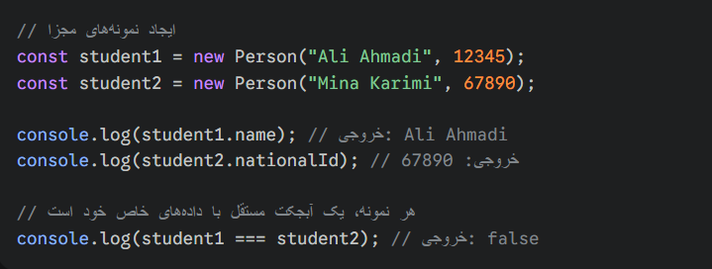
Instance:
To create an object from the class map, we use the new keyword:

Slide 12
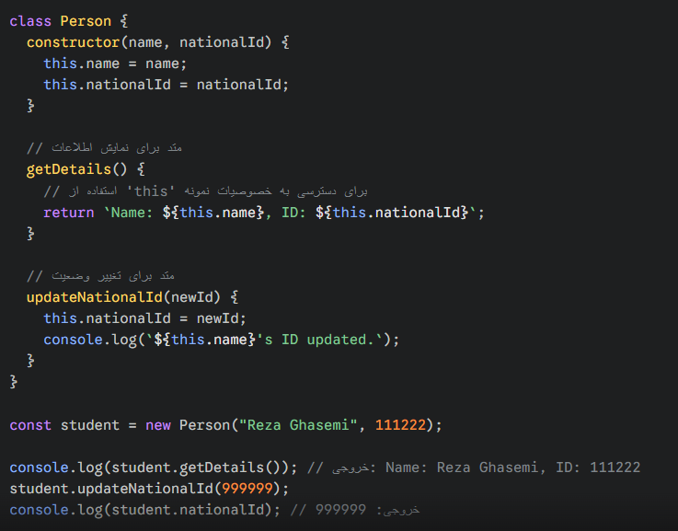
Class Methods:
Methods define the behaviors and capabilities of the constructed object. These methods are defined directly within the class body and do not require the function keyword.

Slide 13
Inheritance:
Inheritance allows a new class (subclass) to inherit properties and methods from an existing class (superclass). This reduces code duplication (DRY Principle).
extends: To define inheritance. Subclass extends Superclass.
super(): Used inside the constructor of the child class to call the constructor of the parent class. It must be called before using this in the child class.
Look at next page 👀

Slide 14
